Slide 1
Successfully Completing a National Center for Health Statistics Research Data Center Request for National Hospital Care Survey Data
Geoff Jackson M.S.
Division of Health Care Statistics
October 24, 2019

Slide 2
Agenda
National Center for Health Statistics Research Data Centers
Restricted National Hospital Care Survey data
Requesting access to National Hospital Care Survey restricted-use data

Slide 3
National Center for Health Statistics Research Data Centers (RDC)

Slide 4
Research Data Center (RDC)
The RDC is operated by the National Center for Health Statistics and allows researchers access to restricted-use data.
The RDC is responsible for protecting the confidentiality of survey respondents, study subjects, or institutions while providing access to restricted-use data for statistical purposes.
To access the data in the RDC you must submit a proposal outlining the requested analysis and results.
The estimated project cost is $3,000 with a range of $1,800 to $12,000. (For more info on fees: https://www.cdc.gov/rdc/b5aprovproj/ap540.htm)
Complete the confidentiality training and forms. (https://www.cdc.gov/rdc/b4confidisc/cfd400.htm)

Slide 5
RDC Locations
The NCHS RDC locations are:
Hyattsville, MD at NCHS headquarters
Atlanta, GA at the CDC Century Center Campus
Washington, DC at the Department of Health and Human Services headquarters
Rockville, MD at the Agency for Healthcare Research and Quality
Federal Statistical RDC (formerly known as Census RDC) are located throughout the country and are partnerships between federal statistical agencies and leading research intuitions. Note: FSRDCs may charge additional fees.

Slide 6
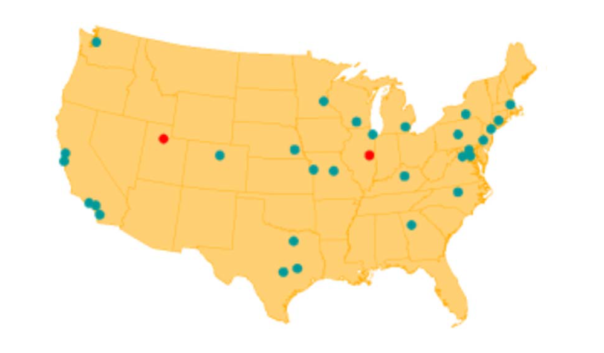
FSRDC locations

Slide 7
Kentucky FSRDC
Located in the Gatton College of Business and Economics on the University of Kentucky campus.
Collaboration between the University of Kentucky and the U.S. Census Bureau, and includes consortium partners of Indiana University, The Ohio State University, University of Cincinnati, and University of Louisville.
Includes data from the Census Bureau, Bureau of Labor
Statistics, and the National Center for Health Statistics.

Slide 8
National Hospital Care Survey (NHCS) Data in the RDC

Slide 9
National Hospital Care Survey (NHCS) Goal and Objectives
Goal:
Provide reliable and timely healthcare utilization data for hospital-based settings.
Objectives:
Move toward electronic data collection, particularly electronic health records.
Provide benchmark data for comparison to national data.
Link episodes of care across hospital units as well as link to other data sources such as the National Death Index (NDI) and CMS Medicare data.

Slide 10
NHCS Sample Design, Data Coverage, and Sources
Hospitals are randomly selected to provide nationally representative data on hospital utilization. The sampled hospitals represent facilities of similar size, service type, and/or geographic location and cannot be replaced.
The 2019 NHCS sample consists of 598 non-institutional, non-federal hospitals with six or more staffed inpatient beds.
Participating hospitals are asked to submit all inpatient discharges and emergency department (ED) visits for up to a 12-month period. Outpatient department (OPD) data was last collected in 2016 and may be added in the future.
Data Sources: UB-04 administrative claims, electronic health records (EHR), and Vizient

Slide 11
NHCS Data in the RDC
There are approximately 125 million unique hospital encounters available from 2013 through 2016.
Encounters are collected from the Inpatient Department (IP), Emergency Department (ED), and Outpatient Department (OPD).

Slide 12
Type of NHCS Data Available in the RDC
Core NHCS data elements:
Survey
Patient
Encounter
Linked data
National Death Index (NDI)
NDI supplemented with results from the Drug Involved in Mortality (DIM) file
CMS Master Beneficiary Summary File

Slide 13
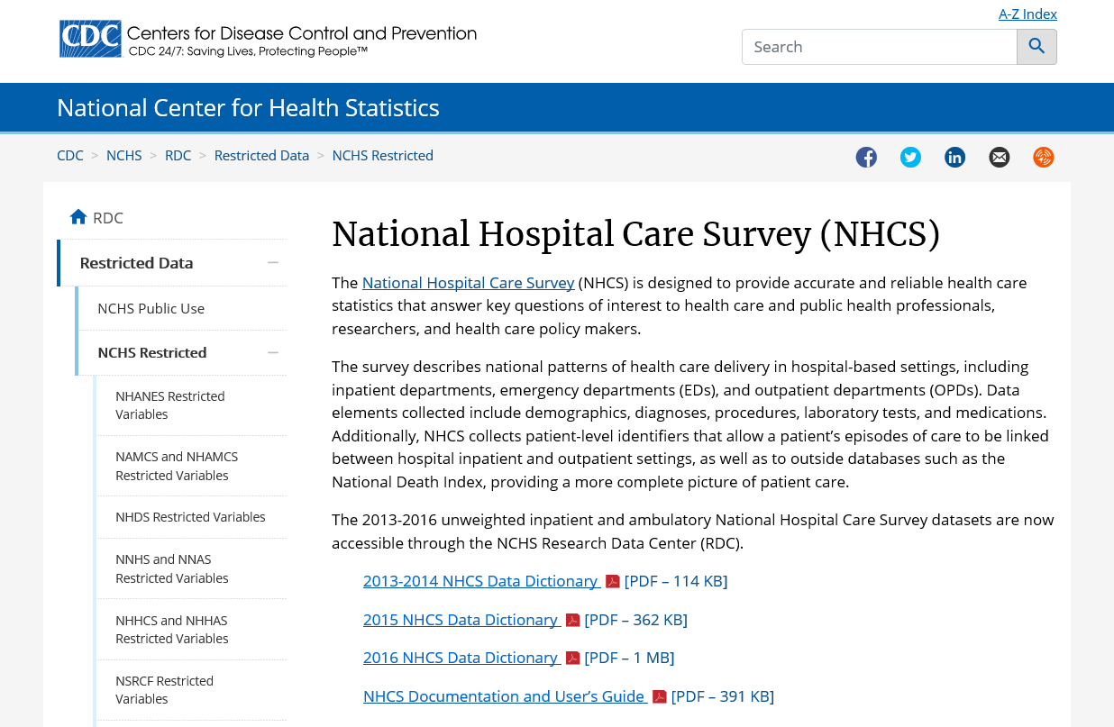
NHCS Core Data Elements
https://www.cdc.gov/rdc/b1datatype/Dt1224h.htm

Slide 14
NHCS RDC Data Dictionaries
2014
2016

Slide 15
External Data Linked to the NHCS Data
NDI is a centralized database of death record information on file in state vital statistics offices; and
MBSF includes information on beneficiary demographic characteristics, reason for Medicare entitlement, and program enrollment type (Original Medicare vs. Medicare Advantage).
https://www.cdc.gov/nchs/data-linkage/nhcs_linkage.htm
CMS MBSF
NHCS
NDI

Slide 16
Data Source: National Death Index (NDI)
Centralized database of death record information on file from state vital statistics offices in the U.S.
Housed at National Center for Health Statistics
Death records added annually from 1979
https://www.cdc.gov/nchs/ndi/index.htm

Slide 17
NHCS – NDI Linkage
Linked NHCS-NDI data offer opportunities to study mortality post hospital discharge
2014 NHCS data are linked to the 2014 and 2015 NDI file.
2016 NHCS data are linked to the 2016 and 2017 NDI file.
The 2014 and 2016 NHCS data are not nationally representative.
Sample weights are not available.
Unweighted estimates may have bias.
NDI
DIM
NHCS

Slide 18
NHCS – NDI Data Available in the RDC
https://www.cdc.gov/nchs/data-linkage/nhcs-ndi.htm

Slide 19
Data Source: Drug Involved in Mortality
Drug Involved in Mortality (DIM), formerly known as NVSS-M-DO, data provide information on specific drugs involved in deaths, extracted from the literal text of death certificates.
The methodology for constructing the DIM data was developed collaboratively between the National Center for Health Statistics and the Food and Drug Administration.
NDI
DIM
NHCS

Slide 20
NHCS – NDI – DIM Linkage
Linked NHCS – NDI – DIM data allow researchers to study specific drugs, drug classes, and non-specific references to drugs mentioned in the literal text of the death certificate.
Allows for look forward and look back analyses.
Drug Overdose Death
Hospital Care

Slide 21
NHCS – NDI – DIM Data Available in the RDC
2014 NHCS linked to the 2014 and 2015 NDI and DIM
Available in 2020: 2016 NHCS linked to the 2016 and 2017 NDI and DIM
https://www.cdc.gov/rdc/data/b1/PCOR_III_data_doc.pdf

Slide 22
Data Source: CMS Master Beneficiary Summary File
Contains data on all Medicare beneficiaries enrolled in/or entitled to Medicare within the calendar year
Includes reason for entitlement
Medicare and Medicaid dual eligibility status
Indicates participation in Medicare Advantage or Fee-for-Service Medicare
Allows for leveraging information on comorbidities (e.g., CMS’ Chronic Conditions Data Warehouse) and Medicare coverage that may be associated with hospital-related service outcomes and health outcomes

Slide 23
NHCS – CMS Linkage
Base (A/B): beneficiary characteristics, monthly entitlement indicators, reasons for entitlement (initial and current), and monthly Medicare Advantage indicators.
Part D: variables specific to Medicare Part D Prescription Drug Plan.
Cost & Utilization: summarized information about the service utilization and Medicare payment amounts by type of claim, including prescription drugs.
Conditions: variables that indicate a Medicare
beneficiary has received a service or treatment
for selected chronic health conditions.
CMS MBSF
NHCS

Slide 24
NHCS – CMS MBSF data in the RDC
2014 NHCS data linked to the 2014 and 2015 CMS MBSF
https://www.cdc.gov/nchs/data-linkage/CMS-Medicare-Restricted.htm
Base (A/B)
Part D
Cost & Utilization
Chronic Conditions

Slide 25
Requesting Access to the NHCS RDC Data

Slide 26
Requesting Access with a Research Proposal
Researchers must submit a research proposal.
The proposal must have the following criteria:
A well-defined research question that addresses a public health concern.
Explanation of what restricted-use variables are needed to complete the project and why.
The disclosure risk associated with:
The requested restricted-use variables
The requested mode of access
Analytic plan (this includes statistical methods) and
The nature and composition of your planned output.

Slide 27
RDC Analyst ‘s Role
Each proposal will be assigned an RDC Analyst.
Facilitates the review
Creates the analytic data set and provides it to the RDC location described in your proposal
Accepts payment
Accepts NCHS Confidentiality required paperwork
Reviews your output for disclosure risk
Provides your approved output

Slide 28
Proposal Process
Determine the need and identify the restricted-use data.
Determine preferred location of access.
Draft your research proposal.
Submit your proposal (using the Proposal Format, include page numbers) as one document to rdca@cdc.gov
Wait for comments form the NCHS Review Committee and respond quickly to expedite any proposal revisions.
Updated your proposal when there are changes.

Slide 29
Drafting a Proposal
The research proposal must comply with the format in the RDC proposal document.
https://www.cdc.gov/rdc/data/b3/Proposal-Format-v3.2.pdf

Slide 30
Example of a Completed Proposal
Using a NCHS published report, National Hospital Care Survey Demonstration Projects Pneumonia Inpatient Hospitalizations and Emergency Department Visits
https://www.cdc.gov/nchs/data/nhsr/nhsr116.pdf

Slide 31
Common Mistakes to Avoid
Do not attempt to misuse the data.
NHCS data are not nationally representative. It cannot be used to produce estimates at the state or national level.
Do not request results that could be used to identify a hospital or patient.
Asking for information produced at the county level or zip code level could be used to identify the participating hospital.
Producing results on rare conditions by low geographic levels or month/date of birth.
Reduce the need for amendments:
Identify all intended results prior to submission and include the tables in the proposal.
Identify all necessary variables in the submission.

Slide 32
Merging Non-NCHS Data in the RDC
Non-NCHS data can be merged to restricted use NCHS data in the RDC.
Researcher must provide the data and identify how to link the data to the data in the RDC.
Example: Identify urban/rural designation of patients in the NHCS data
Patient residence Zip code is available in the NHCS data.
Provide a file with urban/rural designation assigned to Zip code.
Include a data dictionary of the non-NCHS data in the proposal.
Detail the merging of the urban/rural information by Zip code in the proposal.
Detail the intended output by urban/rural designation in the proposal.

Slide 33
Proposal Review
The proposal is reviewed by a committee.
The proposal will not be reviewed for scientific merit.
There are three outcomes of the review:
Revise and resubmit
Approve
Disapprove

Slide 34
To be informed when the application cycle opens, or if you have any questions, please contact nchs@academyhealth.org.

Slide 35
Contact Information
Geoff Jackson
email: mlq2@cdc.gov
phone number: 301-458-4703

